Slide 1
Masked Generative Distillation ECCV 2022
Zhendong Yang
Zhe Li
Mingqi Shao
Dachuan Shi
Zehuan Yuan
Chun Yuan

Slide 2
Outline
Introduction
Related Work
Method
Experiment
Analysis
Conclusion

Slide 3
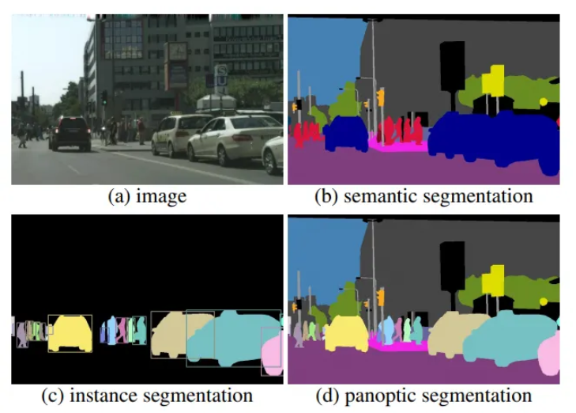
Background
KD methods designed for a specific task are often unavailable for others
Many KD works for classification have failed on dense prediction
Notes:
Dense prediction 是指對每個pixel都給出一個預測值或結果
Classification 是指對整張圖片去預測一個label

Slide 4
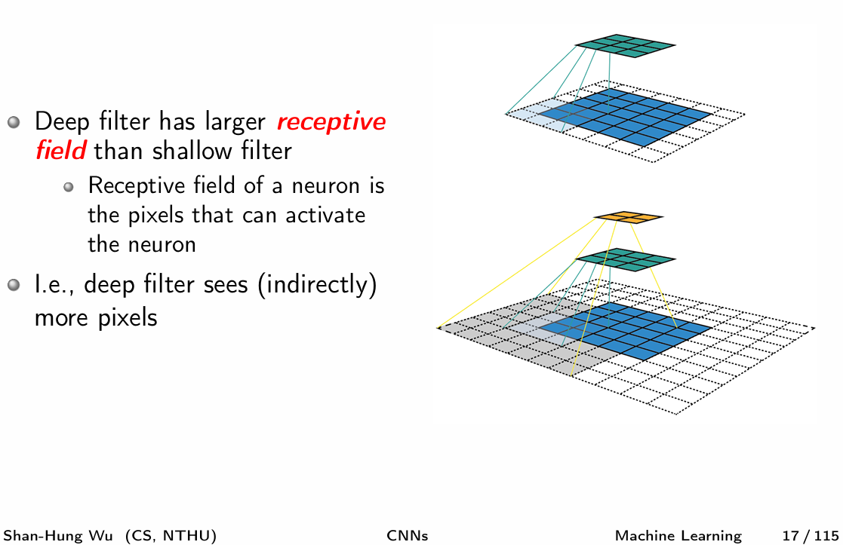
Idea
Mimicking the feature layer outputs of teacher is unnecessary
Feature layers often come from deep network with high-order semantic information
Feature pixels already contain the information of adjacent pixels to a certain extent

Slide 5
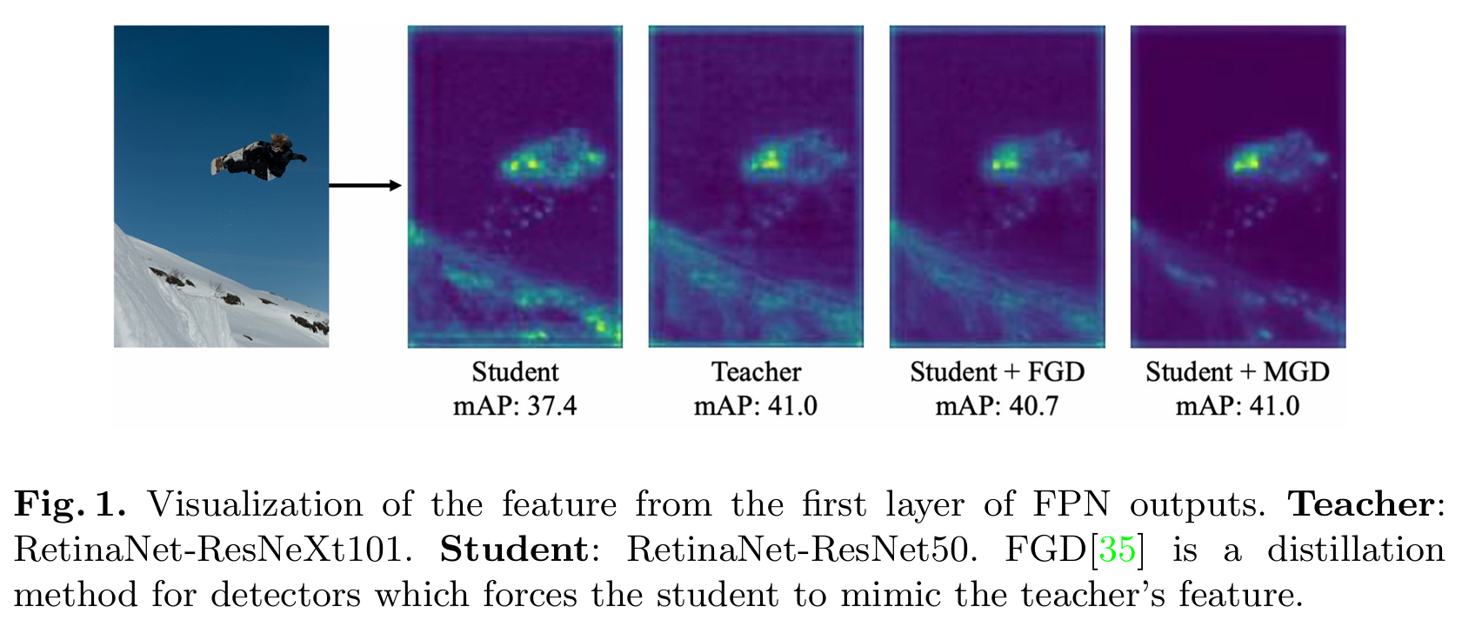
Introduction
Introduce Masked Generative Distillation (MGD)
Mask random pixels of the students feature
Generate the teacher’s full feature with the masked feature through a simple block

Slide 6
Outline
Introduction
Related Work
Method
Experiment
Analysis
Conclusion

Slide 7
KD for Classification
First proposed by Hinton et al. [18], student is supervised by the ground truth and the soften labels from teacher’s last linear layer
AT [36] summaries the values across the channel dimension and transfers the attention knowledge to student
OFD [17] proposes margin ReLU and designs a new function to measure the distance for KD
CRD [30] utilizes contrastive learning to transfer the knowledge to student
KR [4] builds a review mechanism and utilizes multi-level information for KD
SRRL [33] utilizes teacher’s classifier to train student’s penultimate layer feature
WSLD [40] proposes the weighted soft labels for distillation from a perspective of bias-variance trade-off

Slide 8
KD for Object Detection
Chen et al.[1] first calculate the distillation loss on the detector’s neck and head
FGFI [31] utilizes the fine-grained mask to distill the regions near objects
Defeat [13] points out that information from foreground and background are both important
GID [10] chooses the areas where student and teacher perform differently for KD
FKD [37] uses the sum of teacher’s and student’s attention to make student focus on changeable areas
FGD [35] proposes focal distillation to force student to learn teacher’s crucial part and global distillation which compensates for missing global information

Slide 9
KD for Semantic Segmentation
Liu et al.[23] propose pair-wise and holistic distillation, enforcing pair-wise and high-order consistency between the outputs of student and teacher
He et al.[16] reinterpret the output from the teacher network to a re-represented latent domain and capture long-term dependencies from teacher
CWD [29] minimizes KL divergence between the probability map which is calculated by normalizing the activation map of each channel

Slide 10
Outline
Introduction
Related Work
Method
Experiment
Analysis
Conclusion

Slide 11
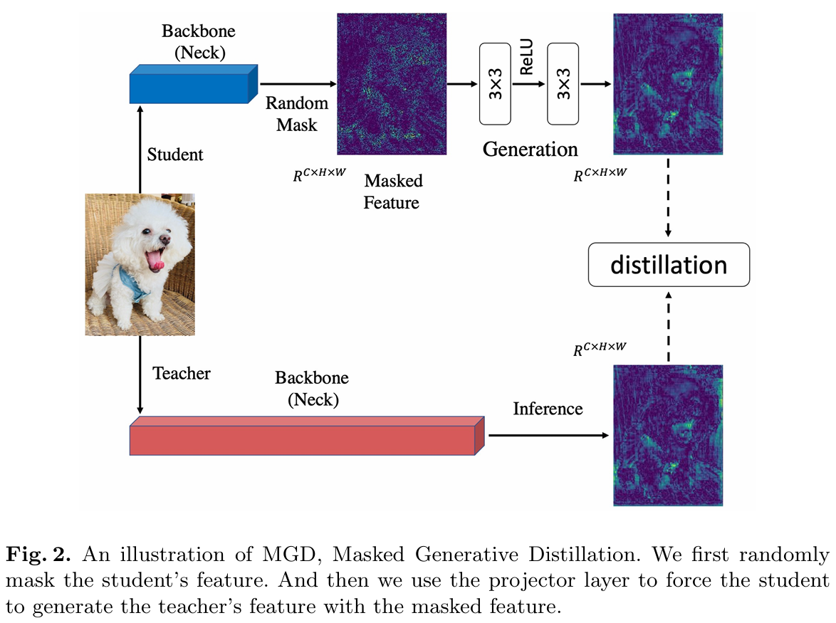
Structure Illustration

Slide 12

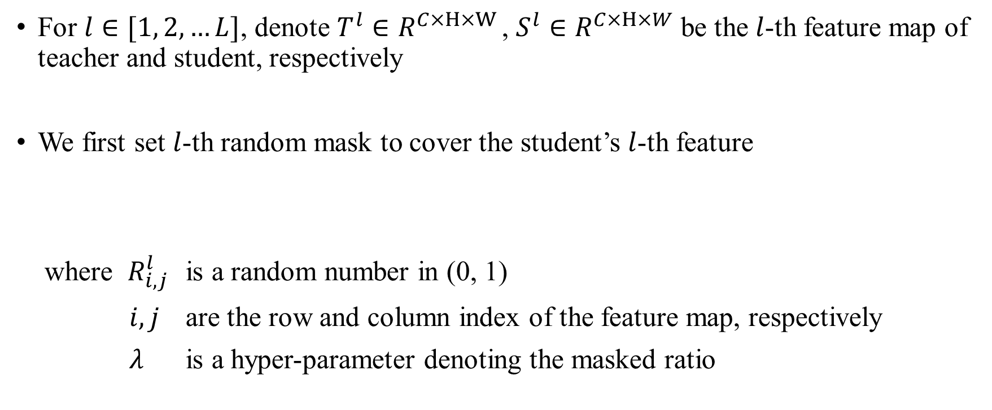
Generation with Masked Feature
For $l∈[1, 2, …L]$, denote $T^{l}∈R^{C×H×W }$, $S^{l}∈R^{C×H×W}$ be the $l$-th feature map of teacher and student, respectively
We first set $l$-th random mask to cover the student’s $l$-th feature
where $R_{i, j}^{l}$ is a random number in (0, 1)
$i, j$ are the row and column index of the feature map, respectively
$λ$ is a hyper-parameter denoting the masked ratio

Slide 13

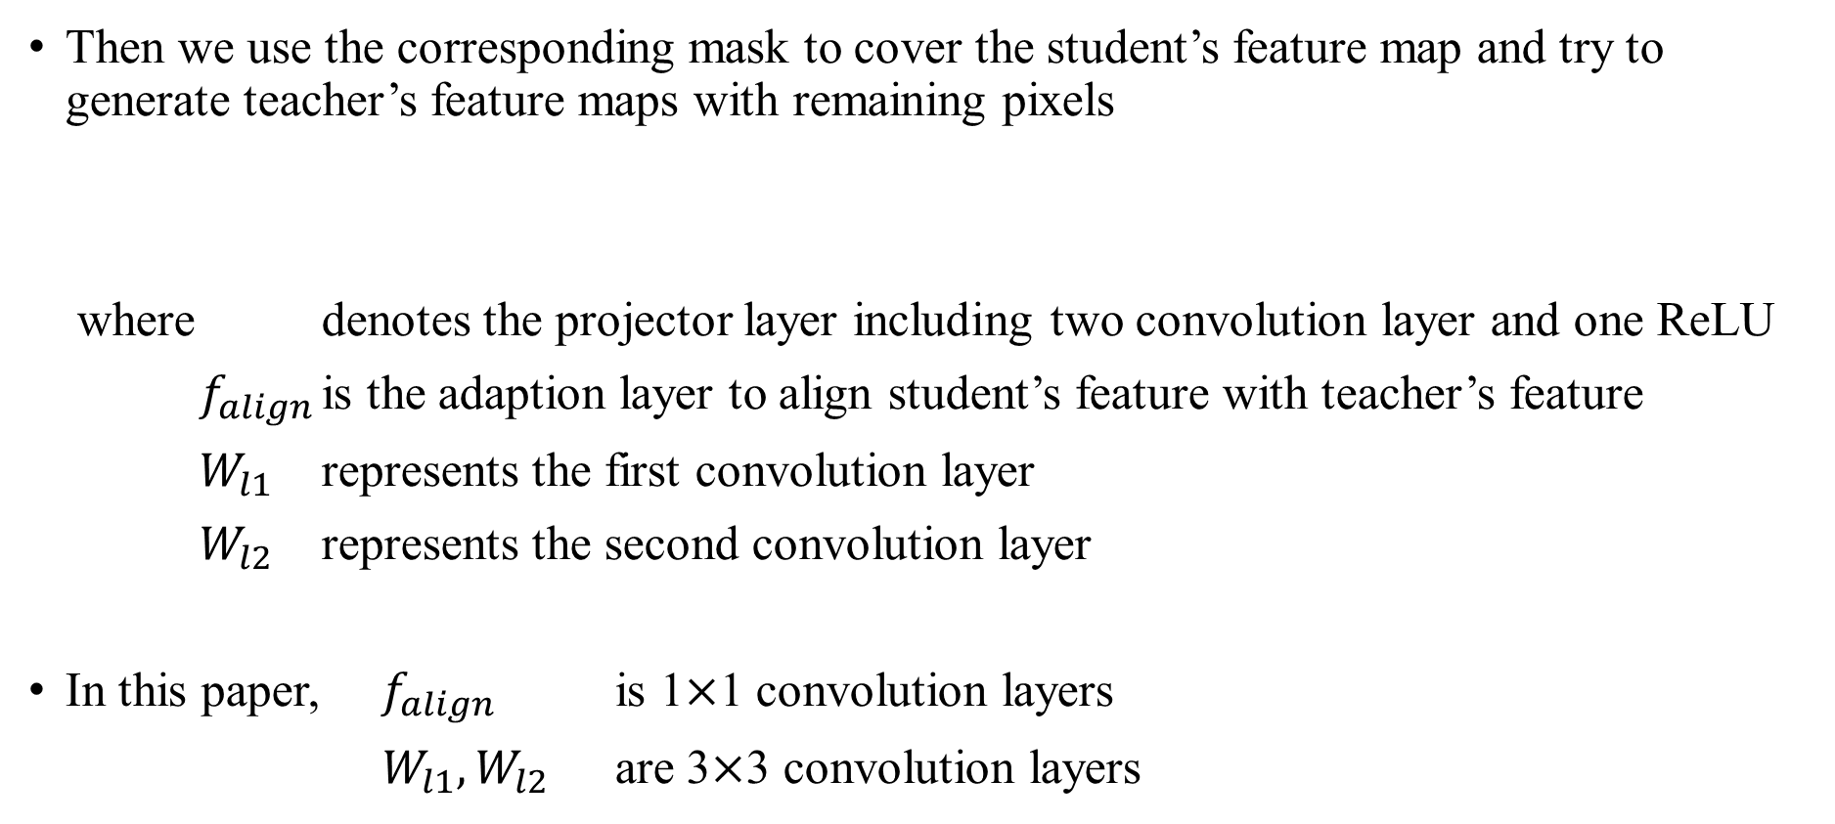
Generation with Masked Feature
Then we use the corresponding mask to cover the student’s feature map and try to generate teacher’s feature maps with remaining pixels
where denotes the projector layer including two convolution layer and one ReLU
$f_{align}$ is the adaption layer to align student’s feature with teacher’s feature
$W_{l1}$ represents the first convolution layer
$W_{l2}$ represents the second convolution layer
In this paper, $f_{align}$ is 1$×$1 convolution layers
$W_{l1}, W_{l2}$ are 3$×$3 convolution layers

Slide 14


Generation with Masked Feature
Finally, we calculate the distillation loss $L_{dis}$ for MGD as follow

Slide 15
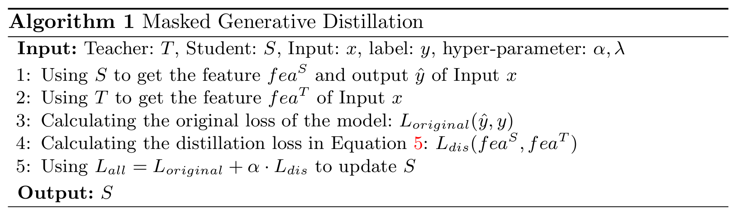
Overall Loss
We train all the models with total loss as follow

Slide 16
Outline
Introduction
Related Work
Method
Experiment
Analysis
Conclusion

Slide 17
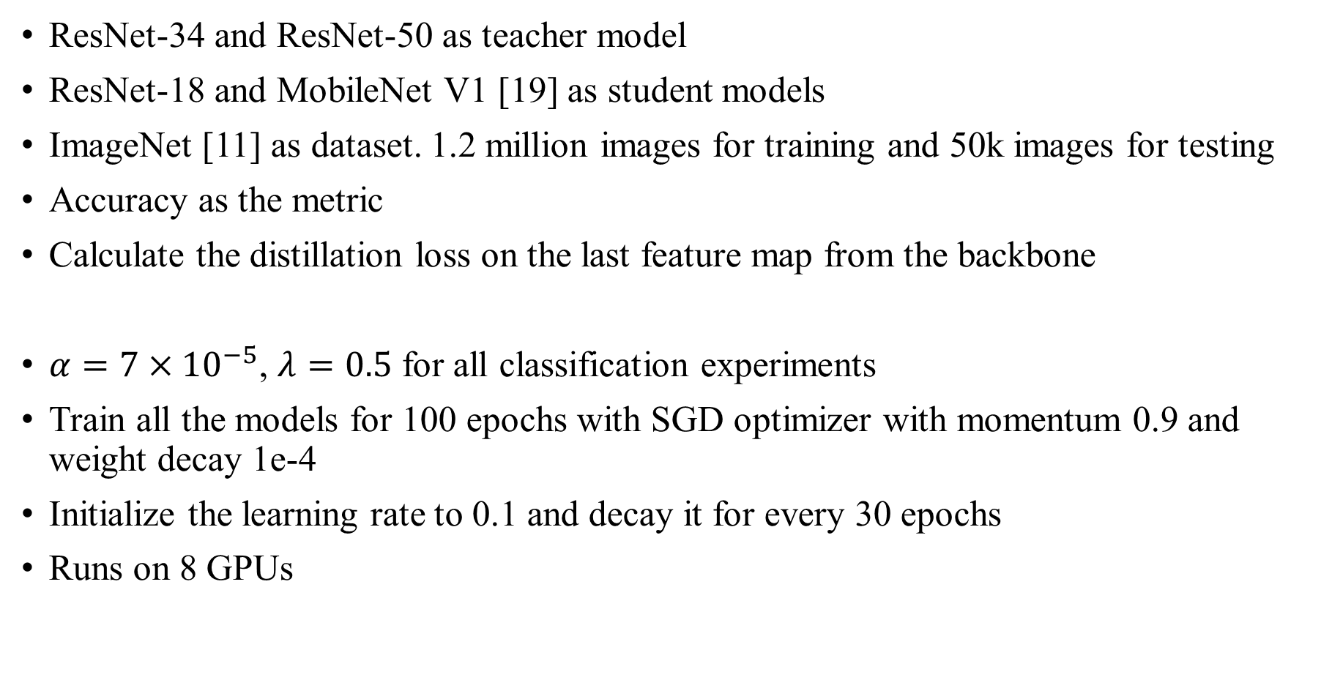
Classification
ResNet-34 and ResNet-50 as teacher model
ResNet-18 and MobileNet V1 [19] as student models
ImageNet [11] as dataset. 1.2 million images for training and 50k images for testing
Accuracy as the metric
Calculate the distillation loss on the last feature map from the backbone
$α=7×{10}^{−5}$, $λ=0.5$ for all classification experiments
Train all the models for 100 epochs with SGD optimizer with momentum 0.9 and weight decay 1e-4
Initialize the learning rate to 0.1 and decay it for every 30 epochs
Runs on 8 GPUs

Slide 18
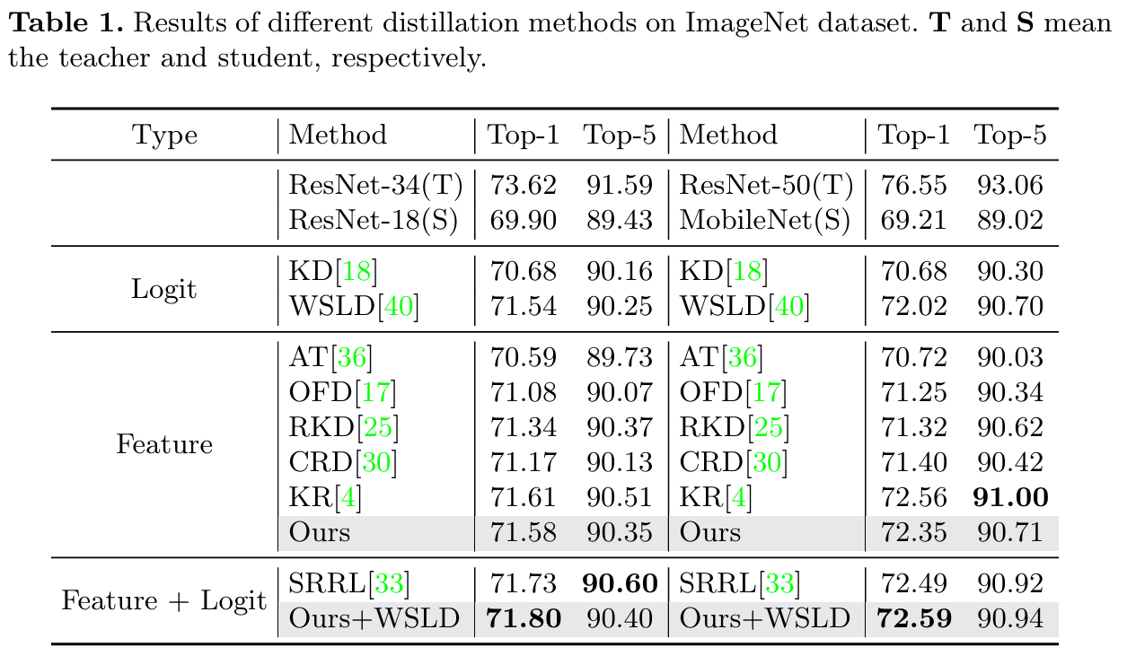
Classification
Notes:
模型會輸出多個預測
Top-1 是指拿模型最有信心的預測去計算accuracy
Top-5 是指拿模型前五名的預測去計算accuracy，只要ground truth有在前五名就算對
Feature KD中，MGD可以接近SOTA
如果結合 logit KD的WSLD，則performance會再進一步提升

Slide 19
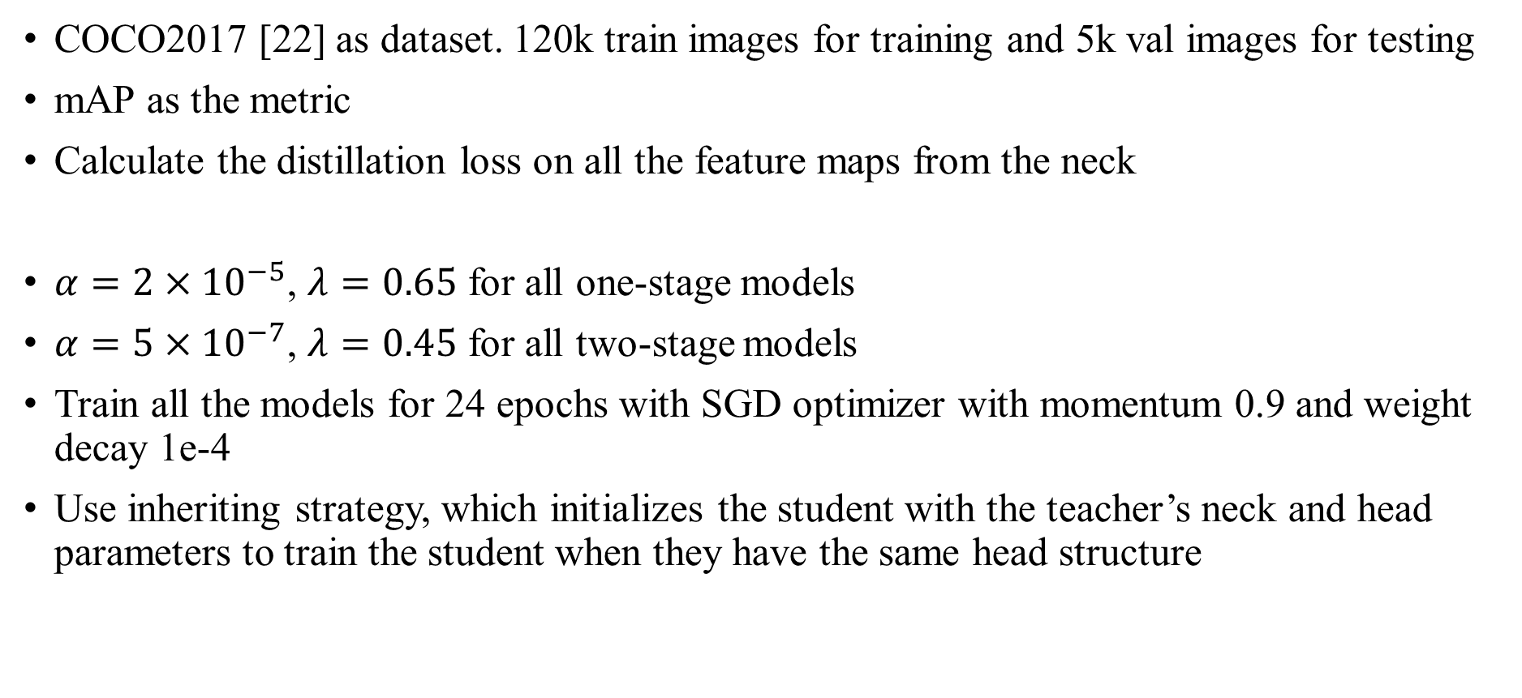
Object Detection and Instance Segmentation
COCO2017 [22] as dataset. 120k train images for training and 5k val images for testing
mAP as the metric
Calculate the distillation loss on all the feature maps from the neck
$α=2×{10}^{−5}$, $λ=0.65$ for all one-stage models
$α=5×{10}^{−7}$, $λ=0.45$ for all two-stage models
Train all the models for 24 epochs with SGD optimizer with momentum 0.9 and weight decay 1e-4
Use inheriting strategy, which initializes the student with the teacher’s neck and head parameters to train the student when they have the same head structure

Slide 20
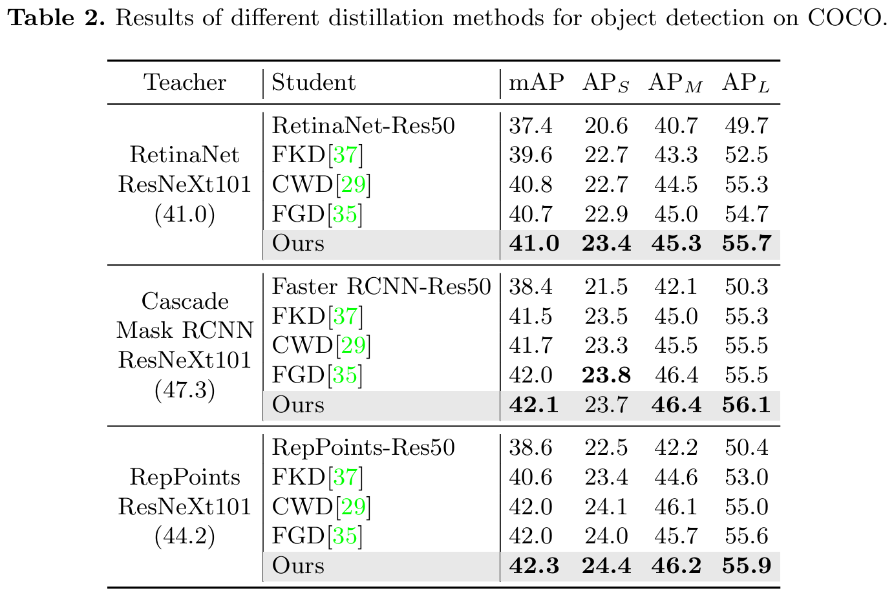
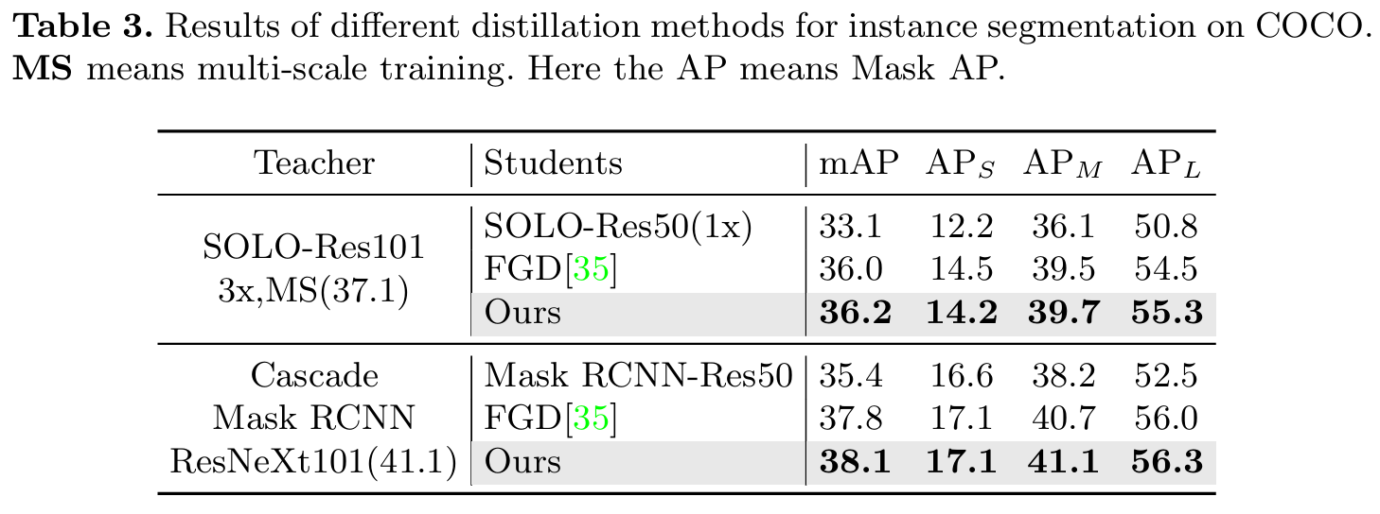
Object Detection and Instance Segmentation
Notes:
全都是SOTA
ResNeXt101是提取圖片特徵的
Teacher 後面括弧的是指原本的mAP
Instance segmentation中的 3x是指epoch乘以幾倍，像是第一組的teacher就是跑了 3 * 24 = 72 個epochs
MS是指在訓練時，輸入的圖片會隨機忽大忽小（改變解析度）。這能讓模型學會看清楚不同大小的物體，通常能顯著提升準確率，但訓練起來很花時間。

Slide 21
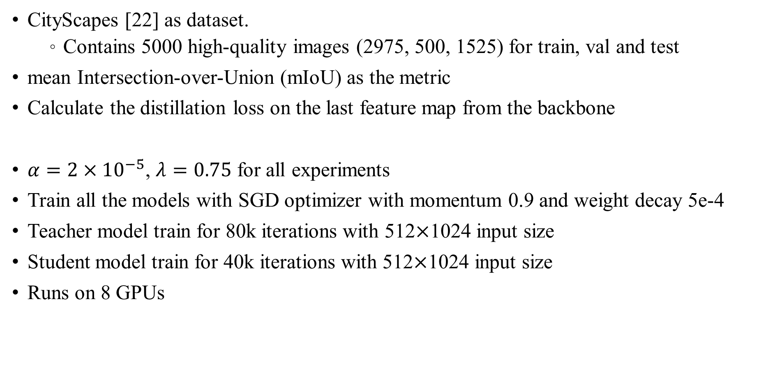
Semantic Segmentation
CityScapes [22] as dataset.
Contains 5000 high-quality images (2975, 500, 1525) for train, val and test
mean Intersection-over-Union (mIoU) as the metric
Calculate the distillation loss on the last feature map from the backbone
$α=2×{10}^{−5}$, $λ=0.75$ for all experiments
Train all the models with SGD optimizer with momentum 0.9 and weight decay 5e-4
Teacher model train for 80k iterations with 512$×$1024 input size
Student model train for 40k iterations with 512$×$1024 input size
Runs on 8 GPUs

Slide 22
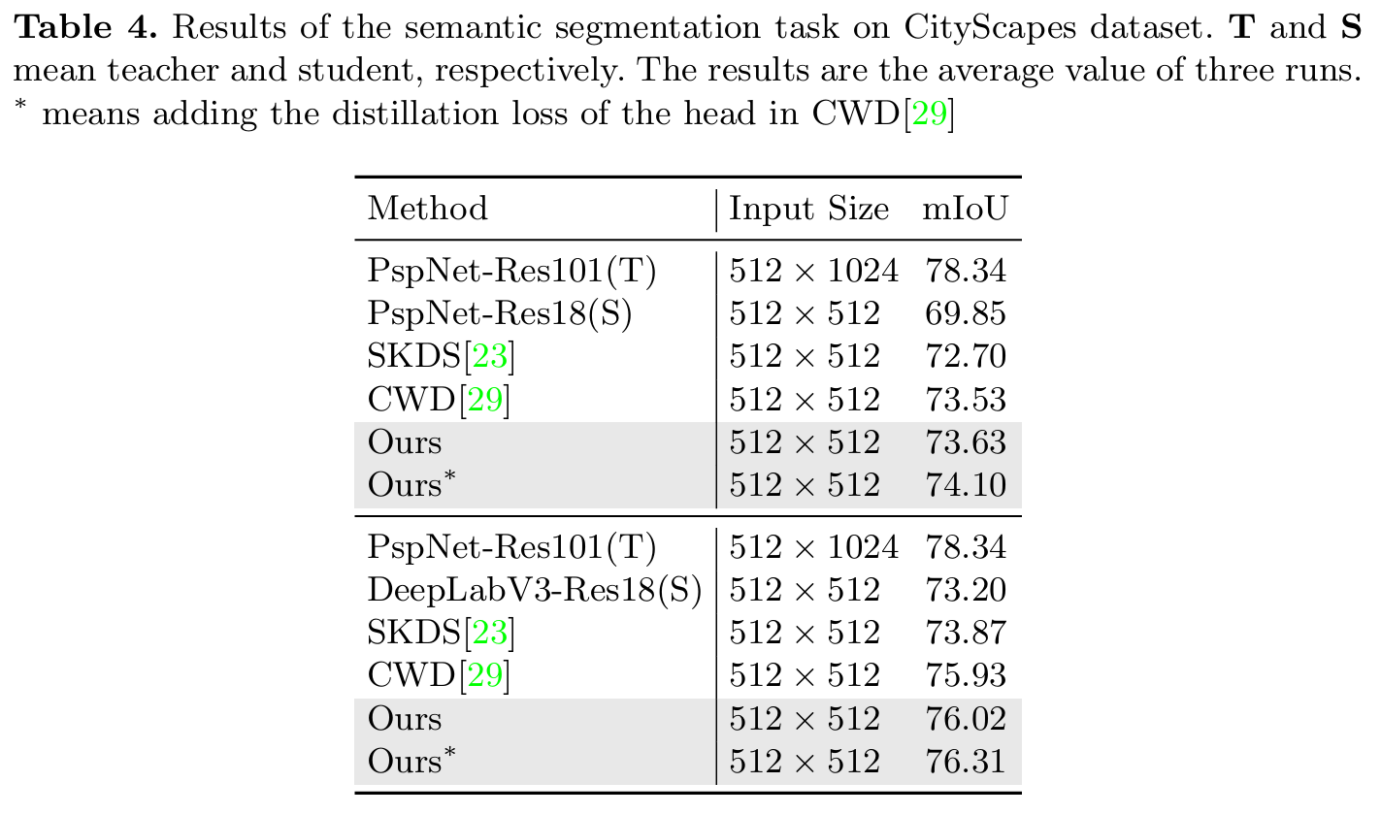
Semantic Segmentation
Notes:
全都是SOTA

Slide 23
Outline
Introduction
Related Work
Method
Experiment
Analysis
Conclusion

Slide 24
MGD V.S. mimicking the teacher
Study this by using the student to teach itself
Firstly, train ResNet-18 as a teacher and the baseline
Then train ResNet-18 to distill itself with MGD
For comparison, train ResNet-18 to distill itself by forcing the student to mimic the teacher directly

Slide 25
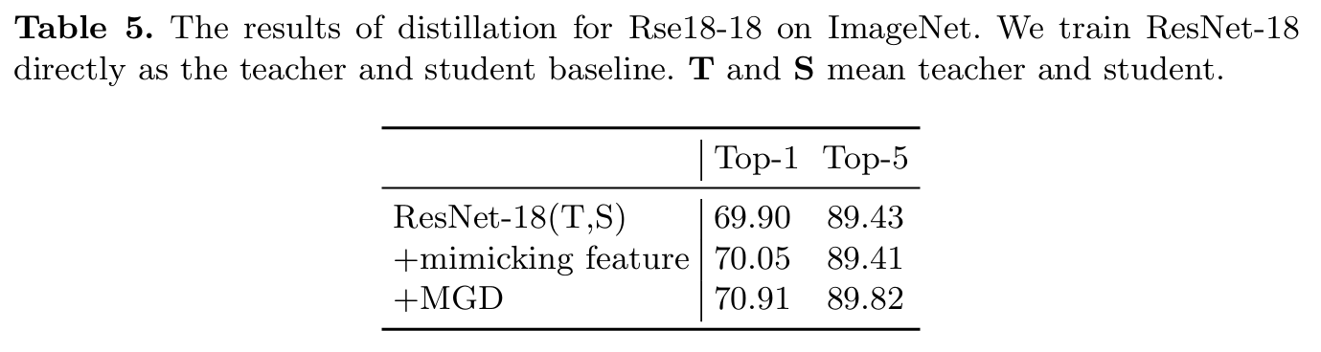
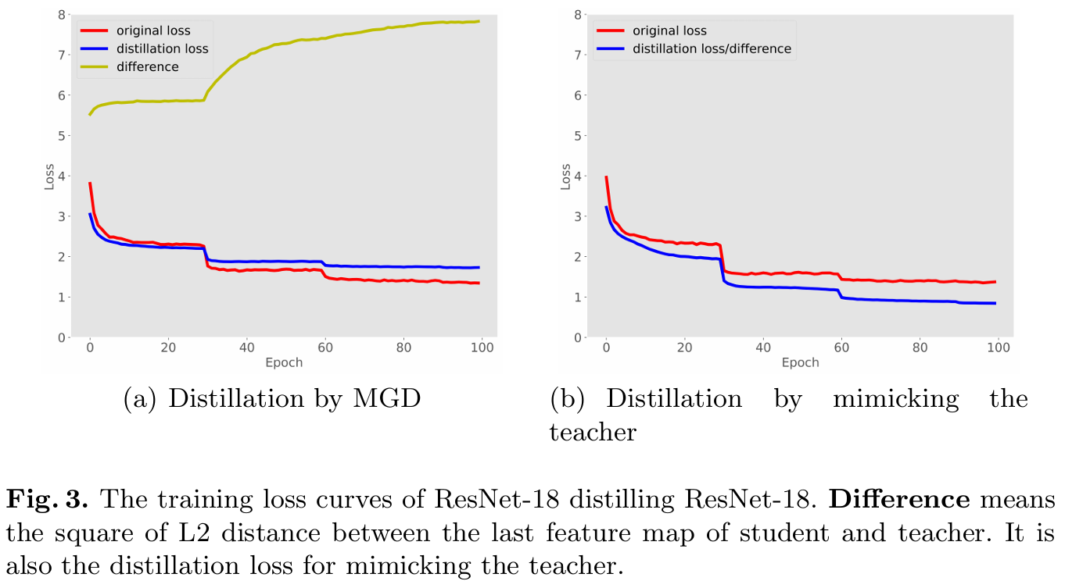
MGD V.S. mimicking the teacher
Notes:
從table 5可以看到即使拿自己當作teacher，用MGD在accuracy也有1%左右的提升，但mimic teacher就沒辦法
Loss curve中的 difference是指square of L2 distance between the last feature map of student and teacher
同時也是 mimic teacher的 distillation loss
從左邊的loss curve可以發現用MGD的話 difference會越來越大
但是student又表現得比teacher好
所以我們可以推測student的feature有更好的representation power

Slide 26
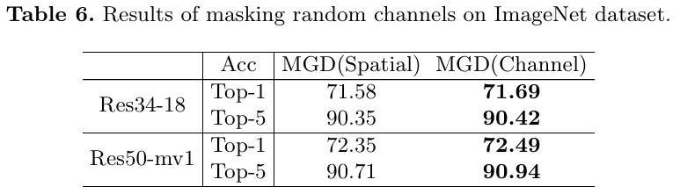

Masking random channels V.S. spatial pixels
For image classification, models usually utilize a pooling layer to reduce the spatial dimension of the feature map
Pooling layer makes the model more sensitive to the channels than spatial pixels
We try to apply MGD by masking random channels instead of spatial pixels
Masked ratio $λ=0.15$, $α=7×{10}^{−5}$

Slide 27
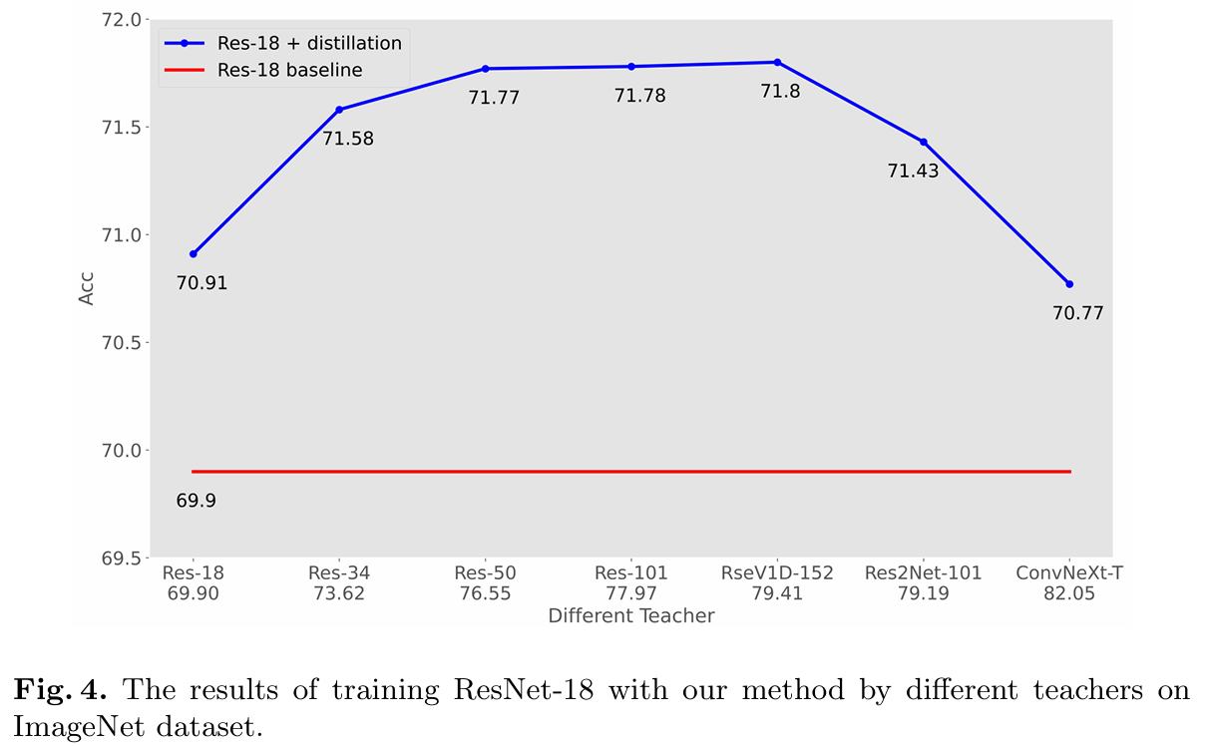
Distillation with different teachers
Cho et al.[5] show the teacher with higher accuracy may not be the better teacher for knowledge distillation on image classification (Conclusion based on logit-based KD)
We study this conclusion by using different kinds of teachers to distill the same student ResNet-18
Notes:
當teacher與student有相似的架構時，teacher benefit more to student
當teacher與student架構不相似時，student很難去generate teacher’s feature map

Slide 28
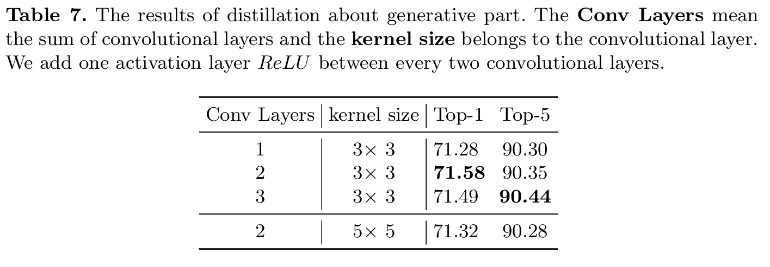
Different generative block
We explore the effects of the generative block with different compositions
Notes:
只有一層CONV的話效果不大
三層CONV效果會比兩層差

Slide 29
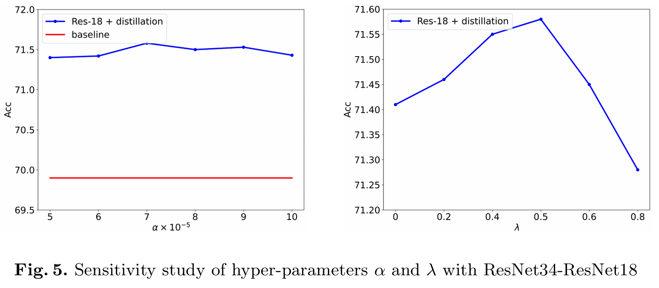

Sensitive of hyper-parameters
In this paper, we use $α$ as the weight of $L_{dis}$ and $λ$ as the mask ratio
We do the sensitivity study of the hyper-parameters by using ResNet-34 to distill ResNet-18 on ImageNet dataset
Notes:
可以看到MGD對 alpha不敏感
ACC在 lambda < 0.5的時候越大表現越好，但>0.5後會drop dramatically

Slide 30
Outline
Introduction
Related Work
Method
Experiment
Analysis
Conclusion

Slide 31
Conclusion
We propose a new way for knowledge distillation, which forces the student to generate the teacher’s feature with its masked feature instead of mimicking it directly.
Based on this way, we propose Masked Generative Distillation (MGD), which is a simple and efficient feature-based KD method
The students can obtain stronger representation power with MGD
MGD is based on the feature map, so it can easily be applied to various tasks

Slide 32
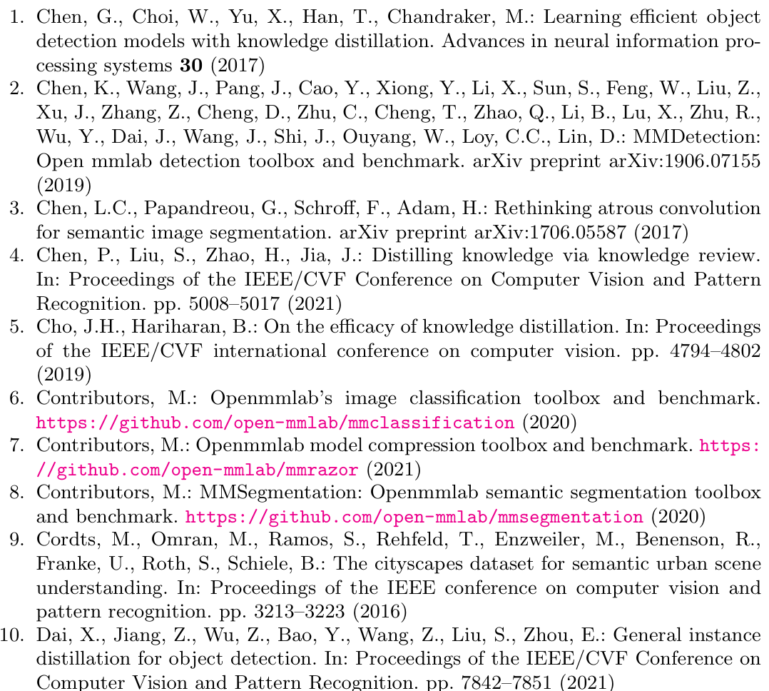
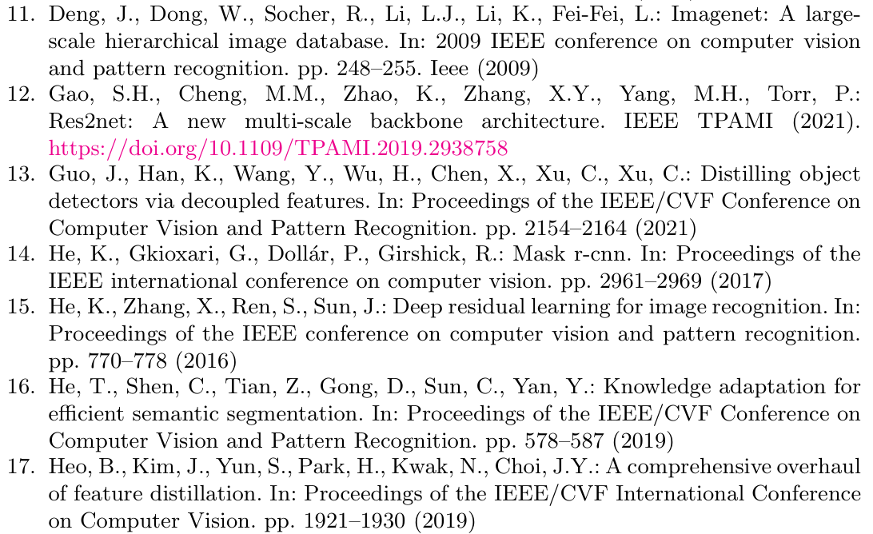
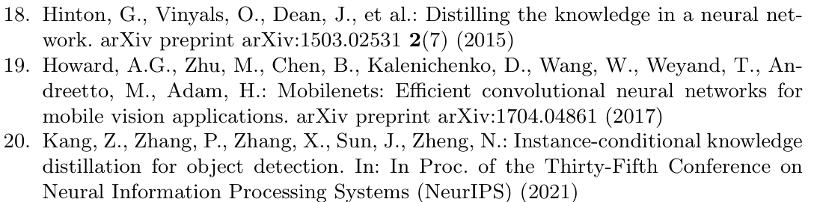
Reference

Slide 33
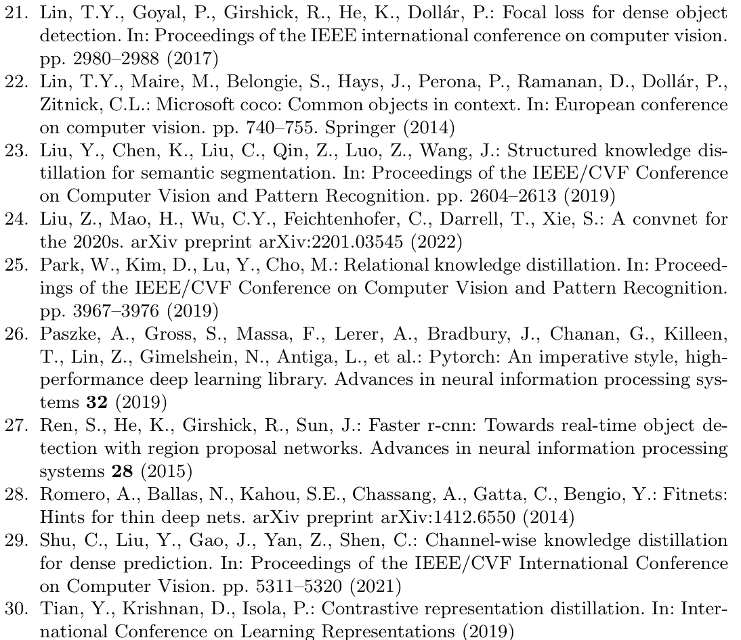
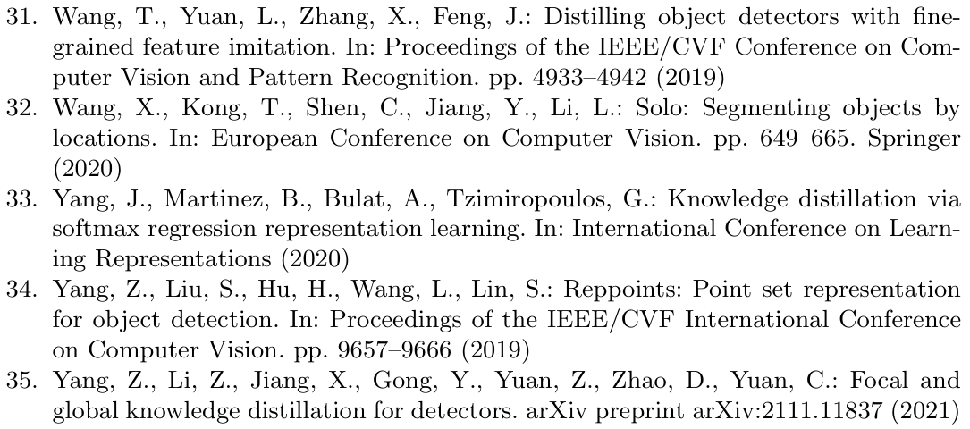
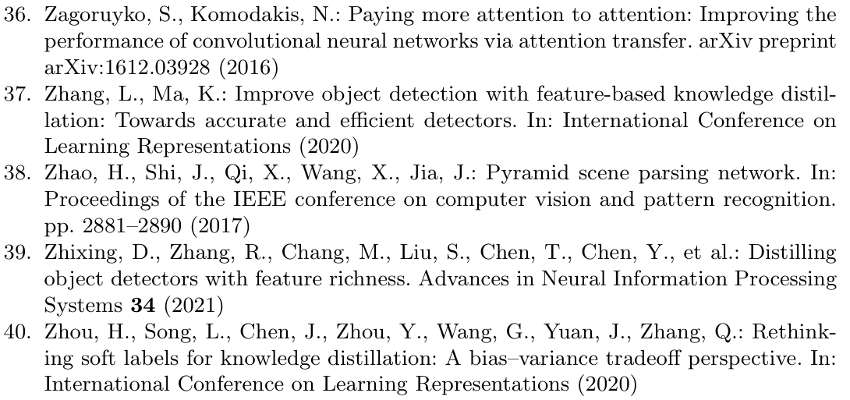
Reference

